Slide 1
(a) Double-PQ
(b) Four-Pole
(c) Modified EE
(d) Vertical Gap

Slide 2
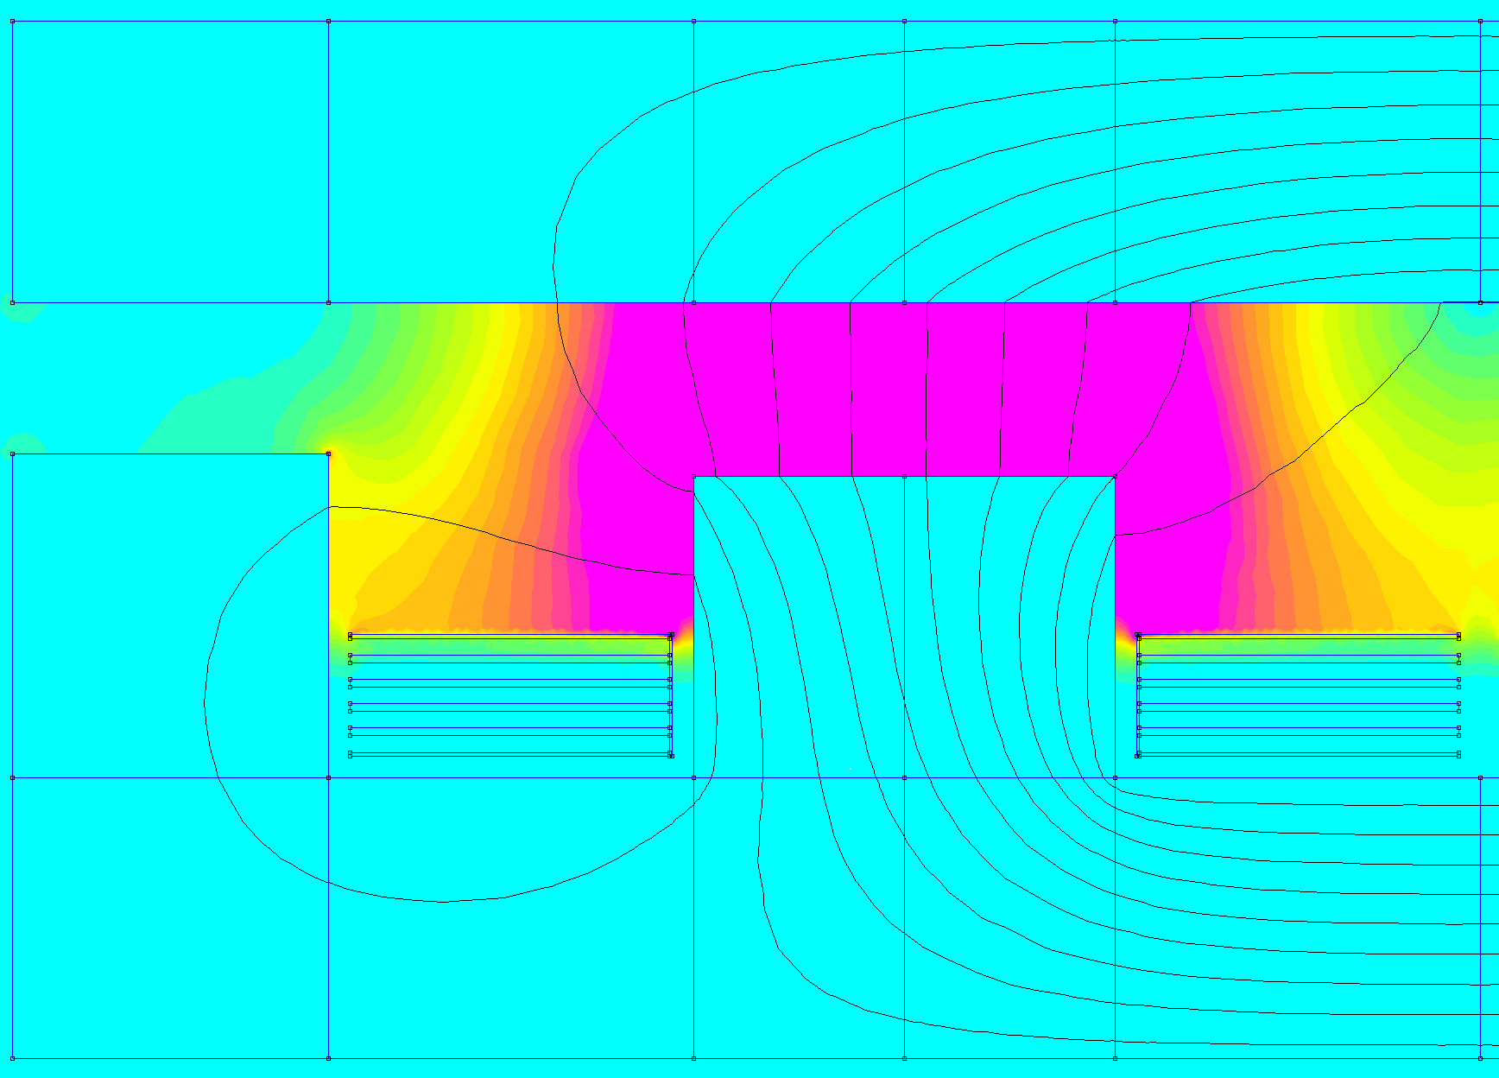
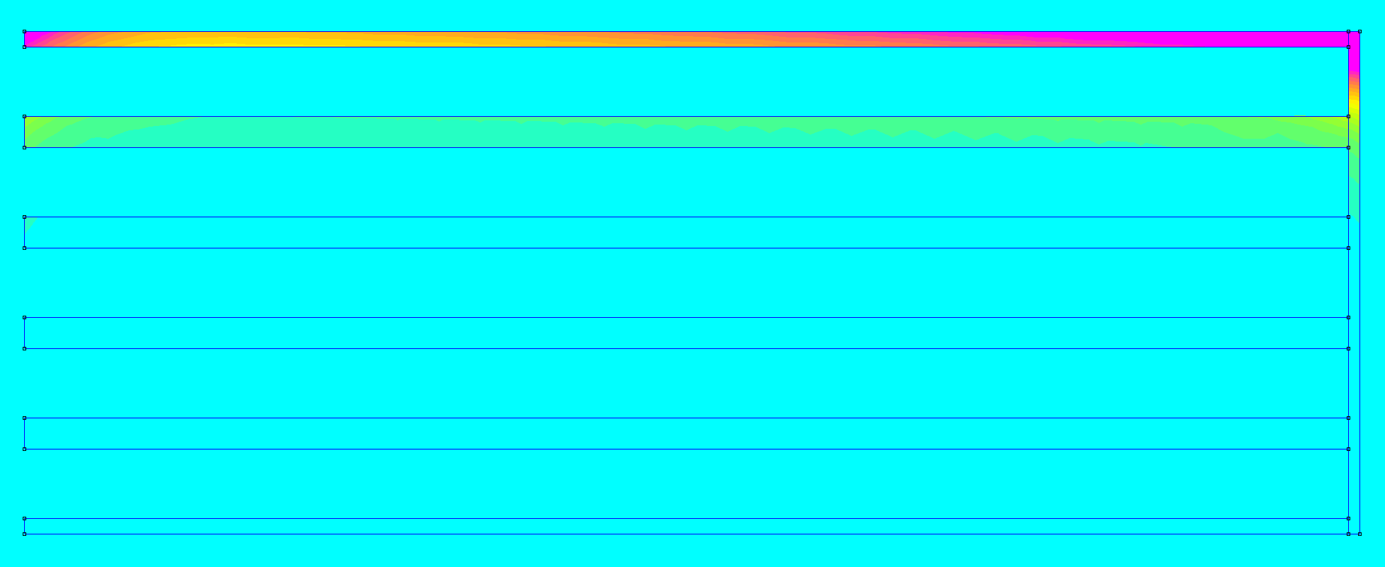
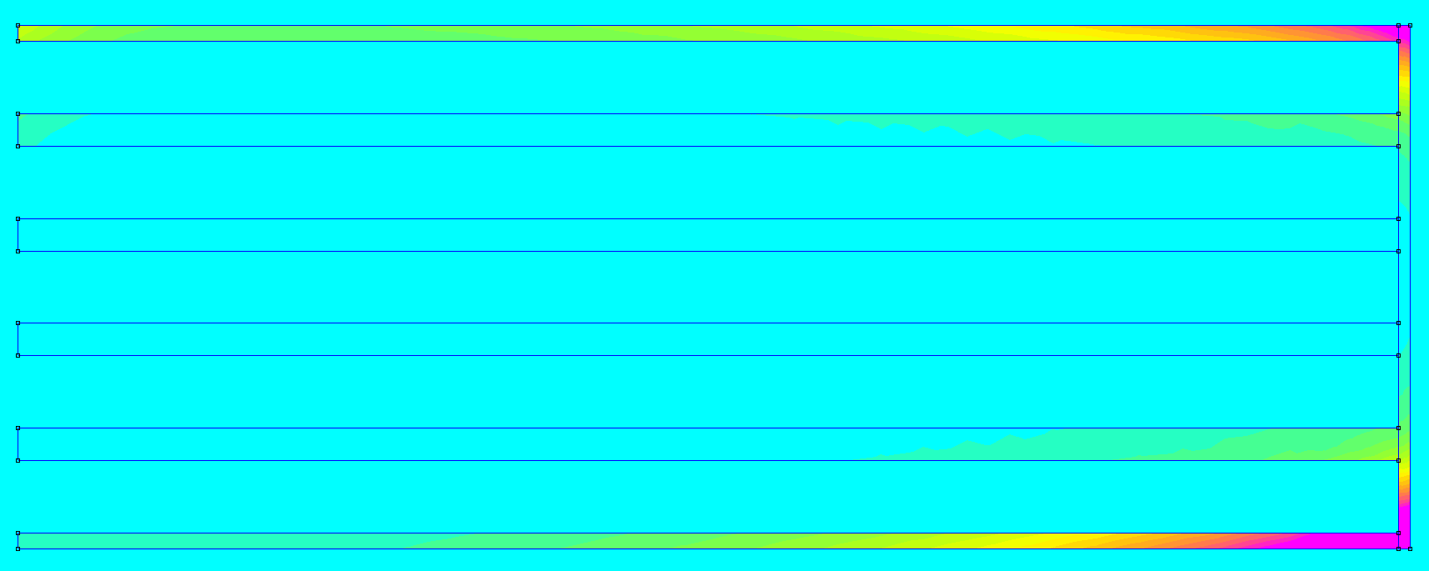
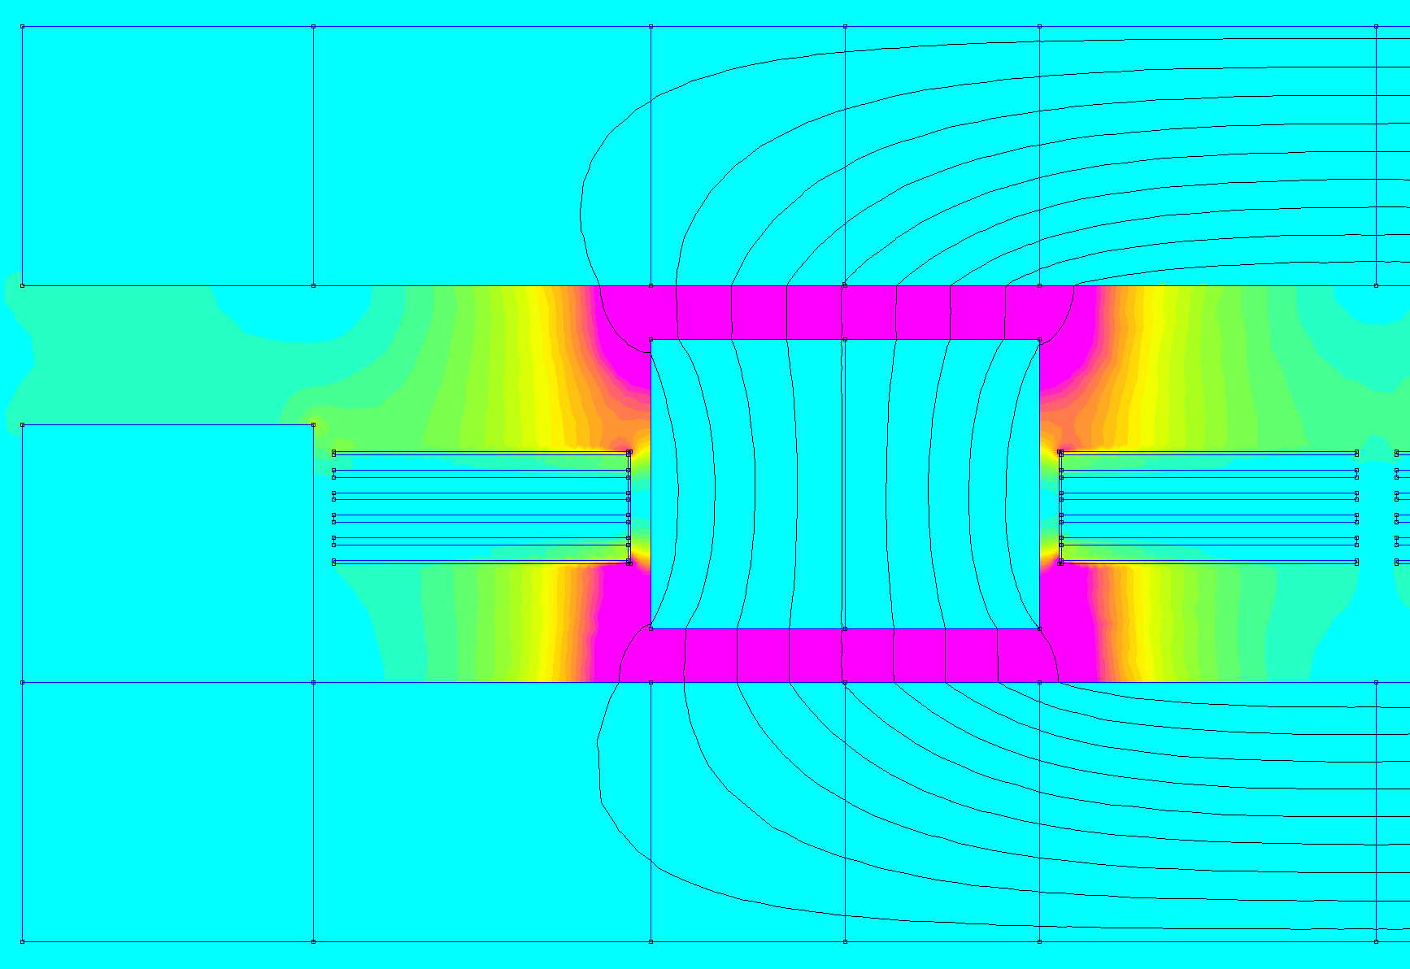
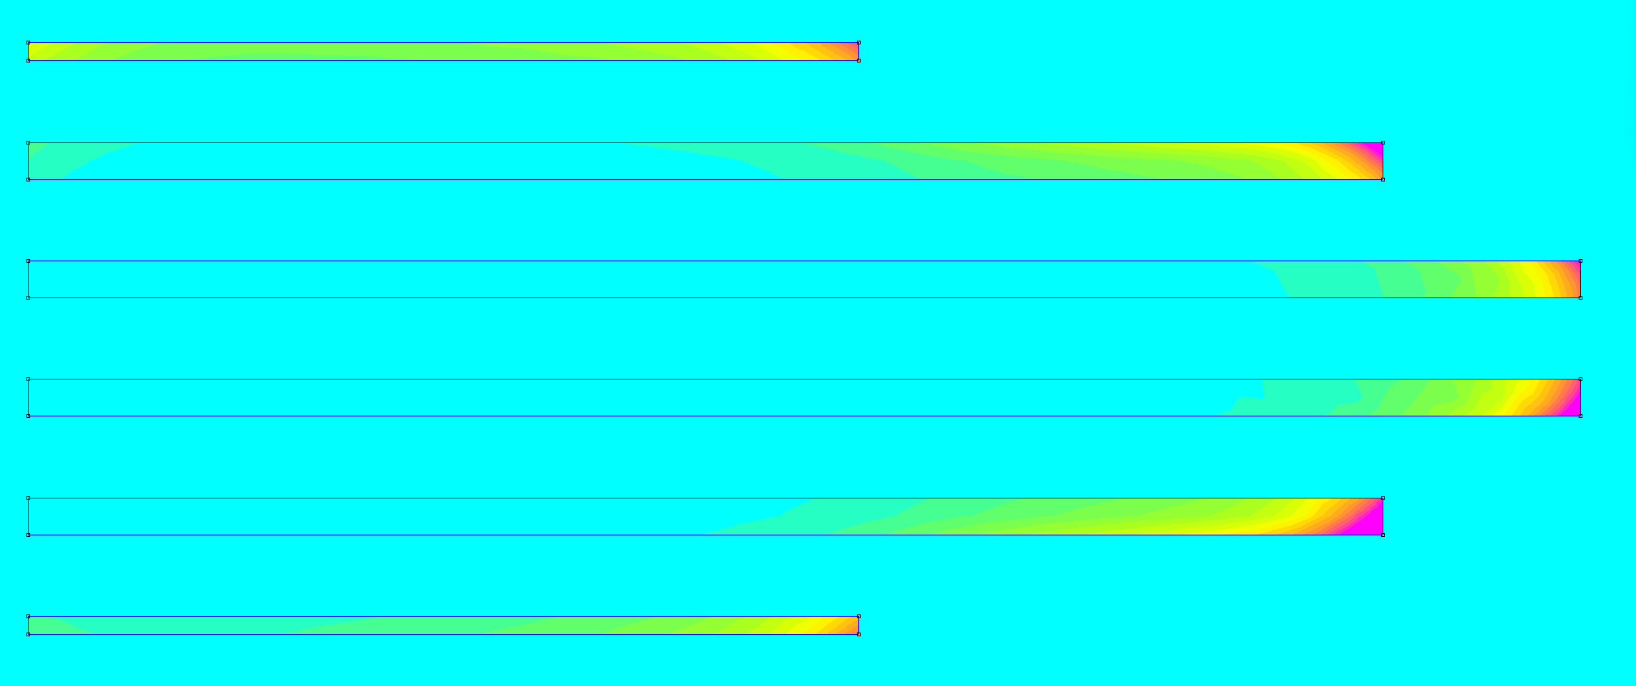
Field intensity (0 – 10 kA/m)
Current density (0 – 300 A/mm^2)

Slide 3
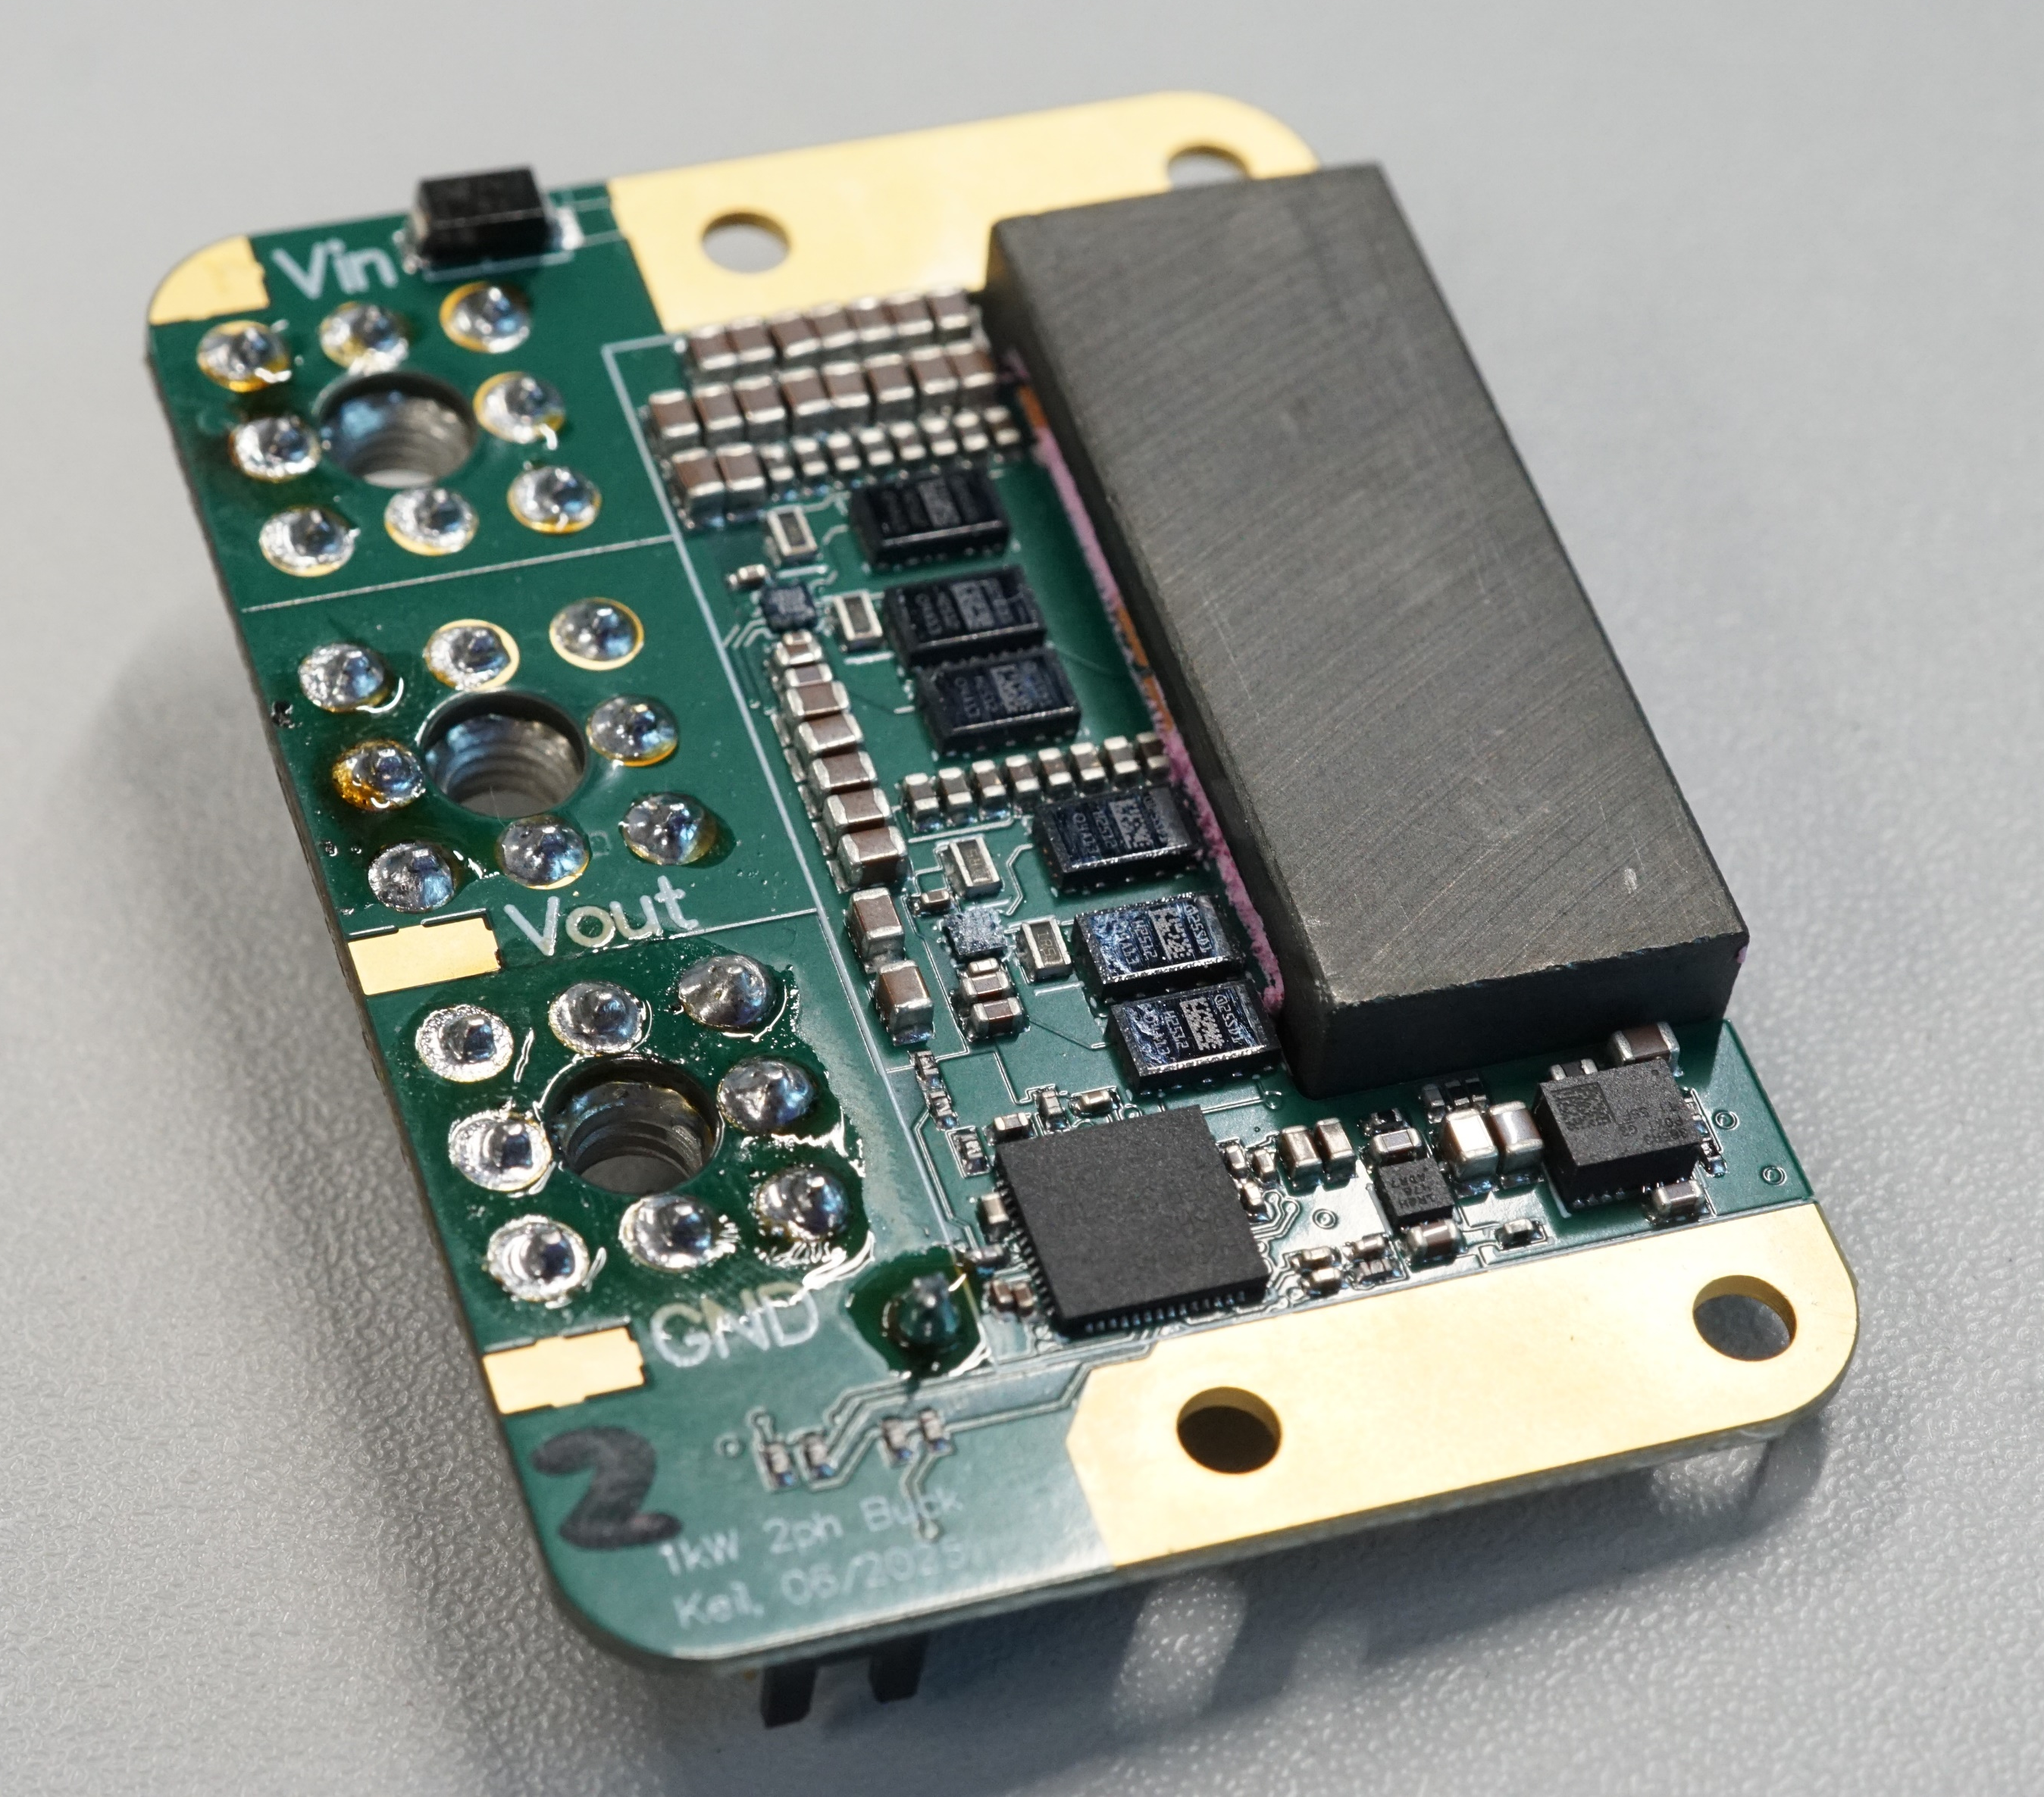
45 mm
29 mm

Slide 4
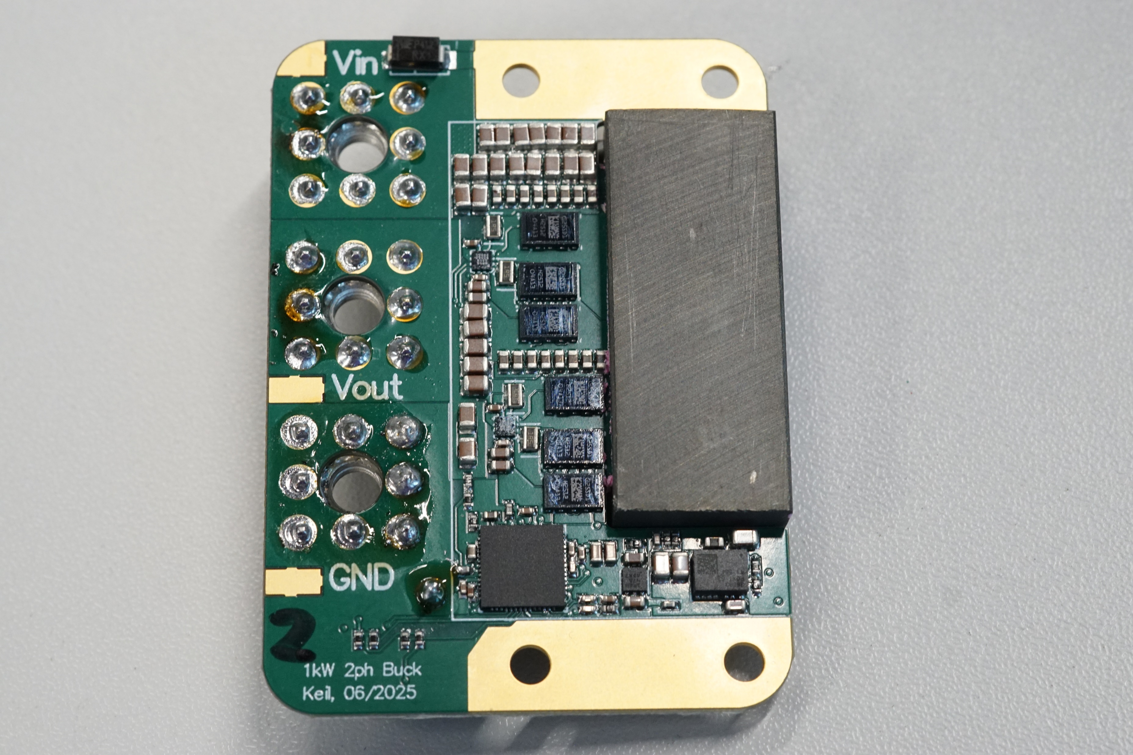
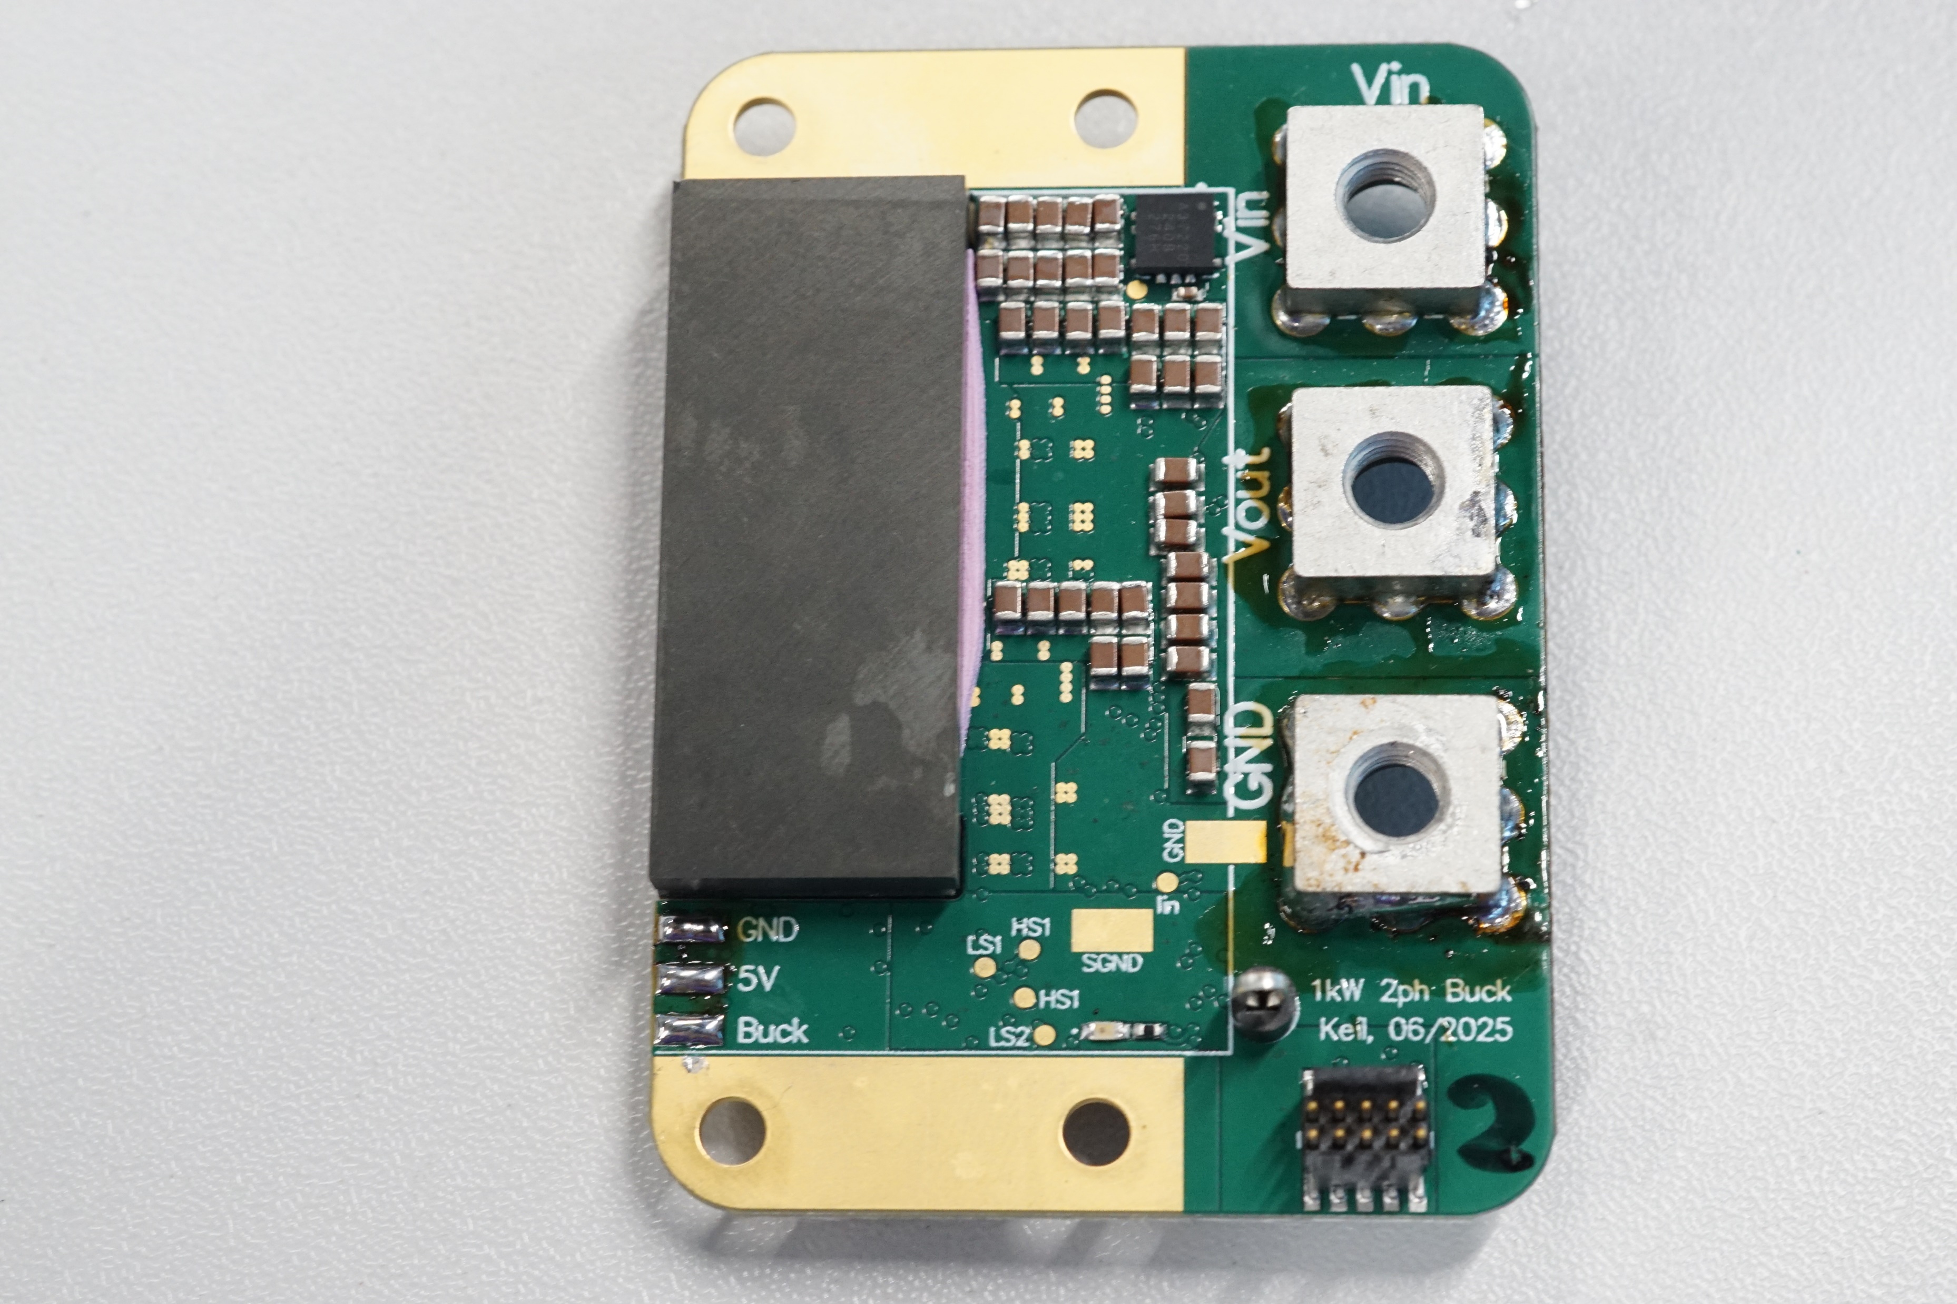
45 mm
29 mm

Slide 5
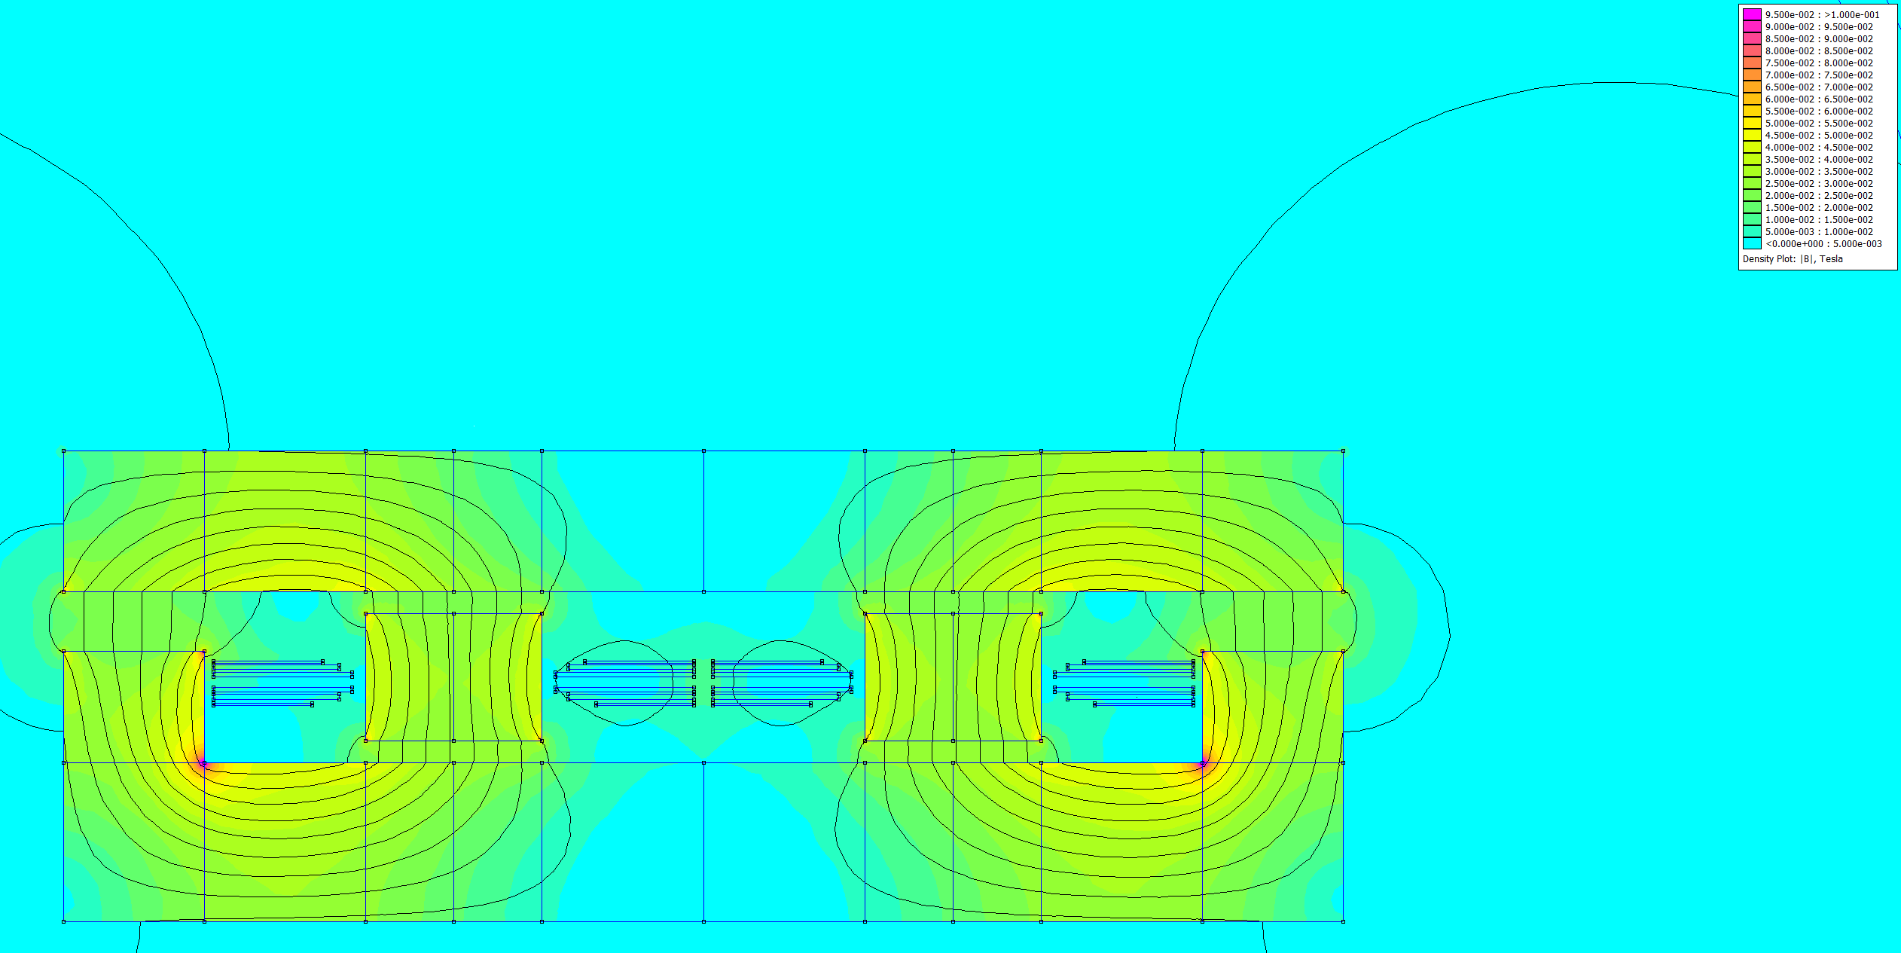
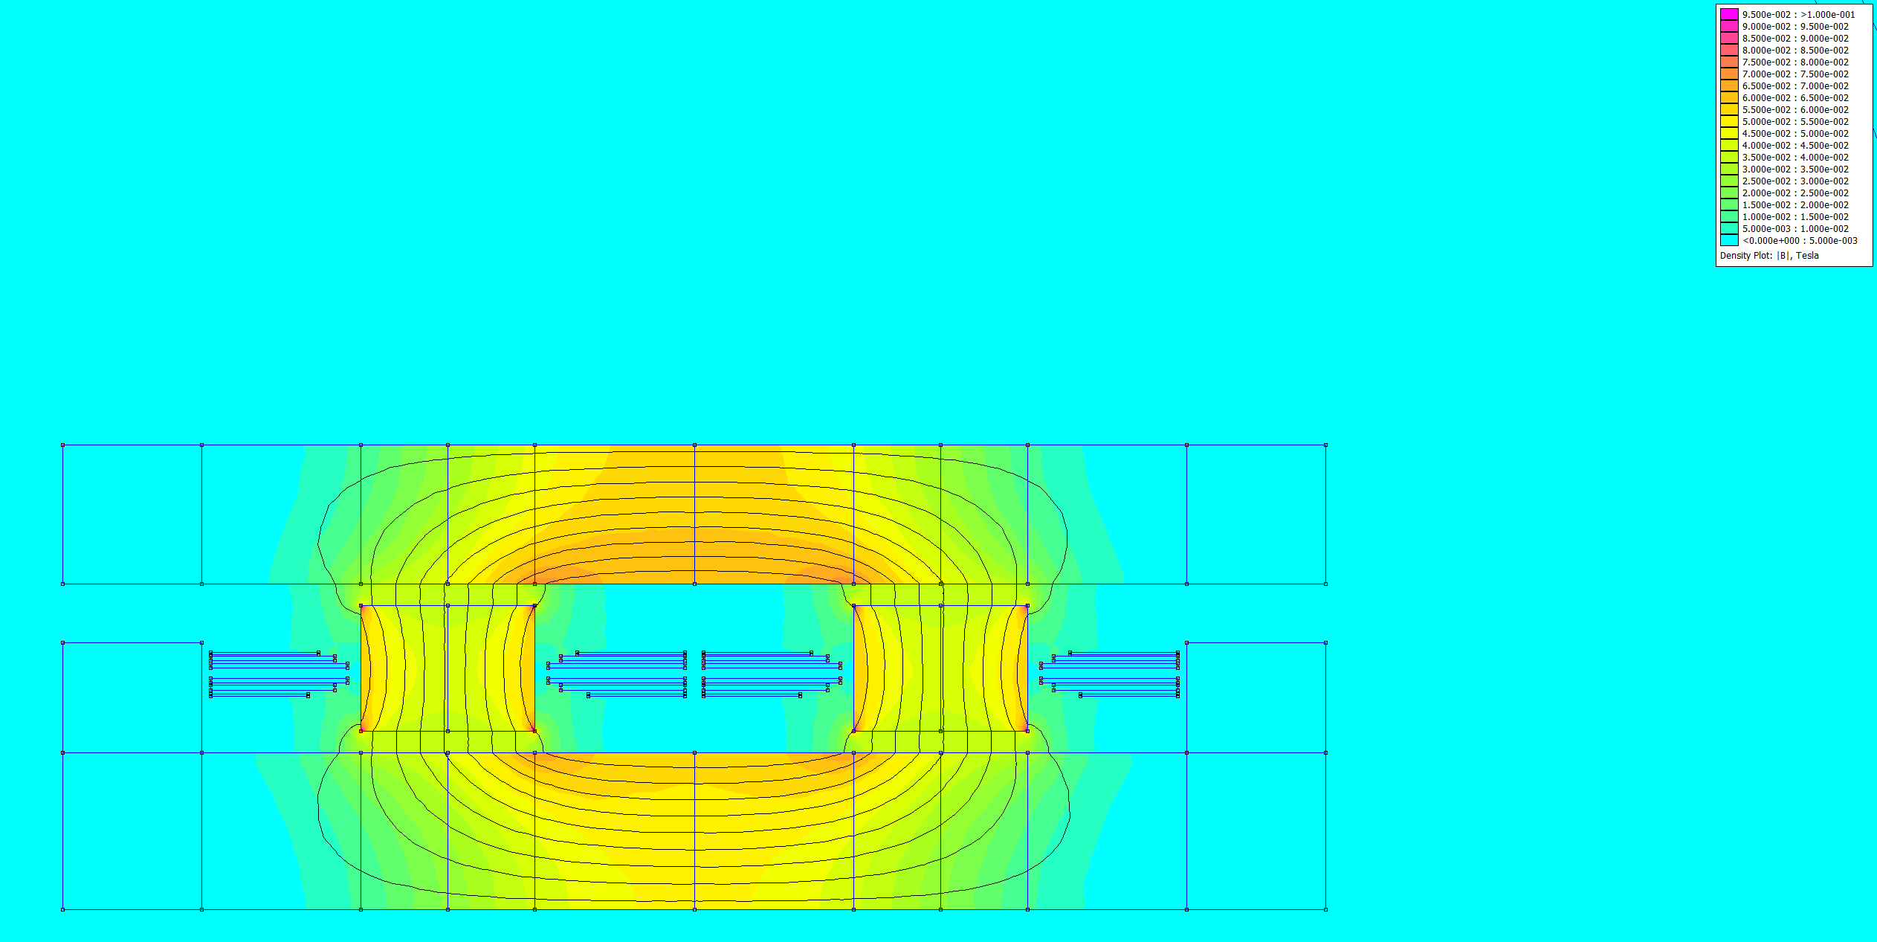
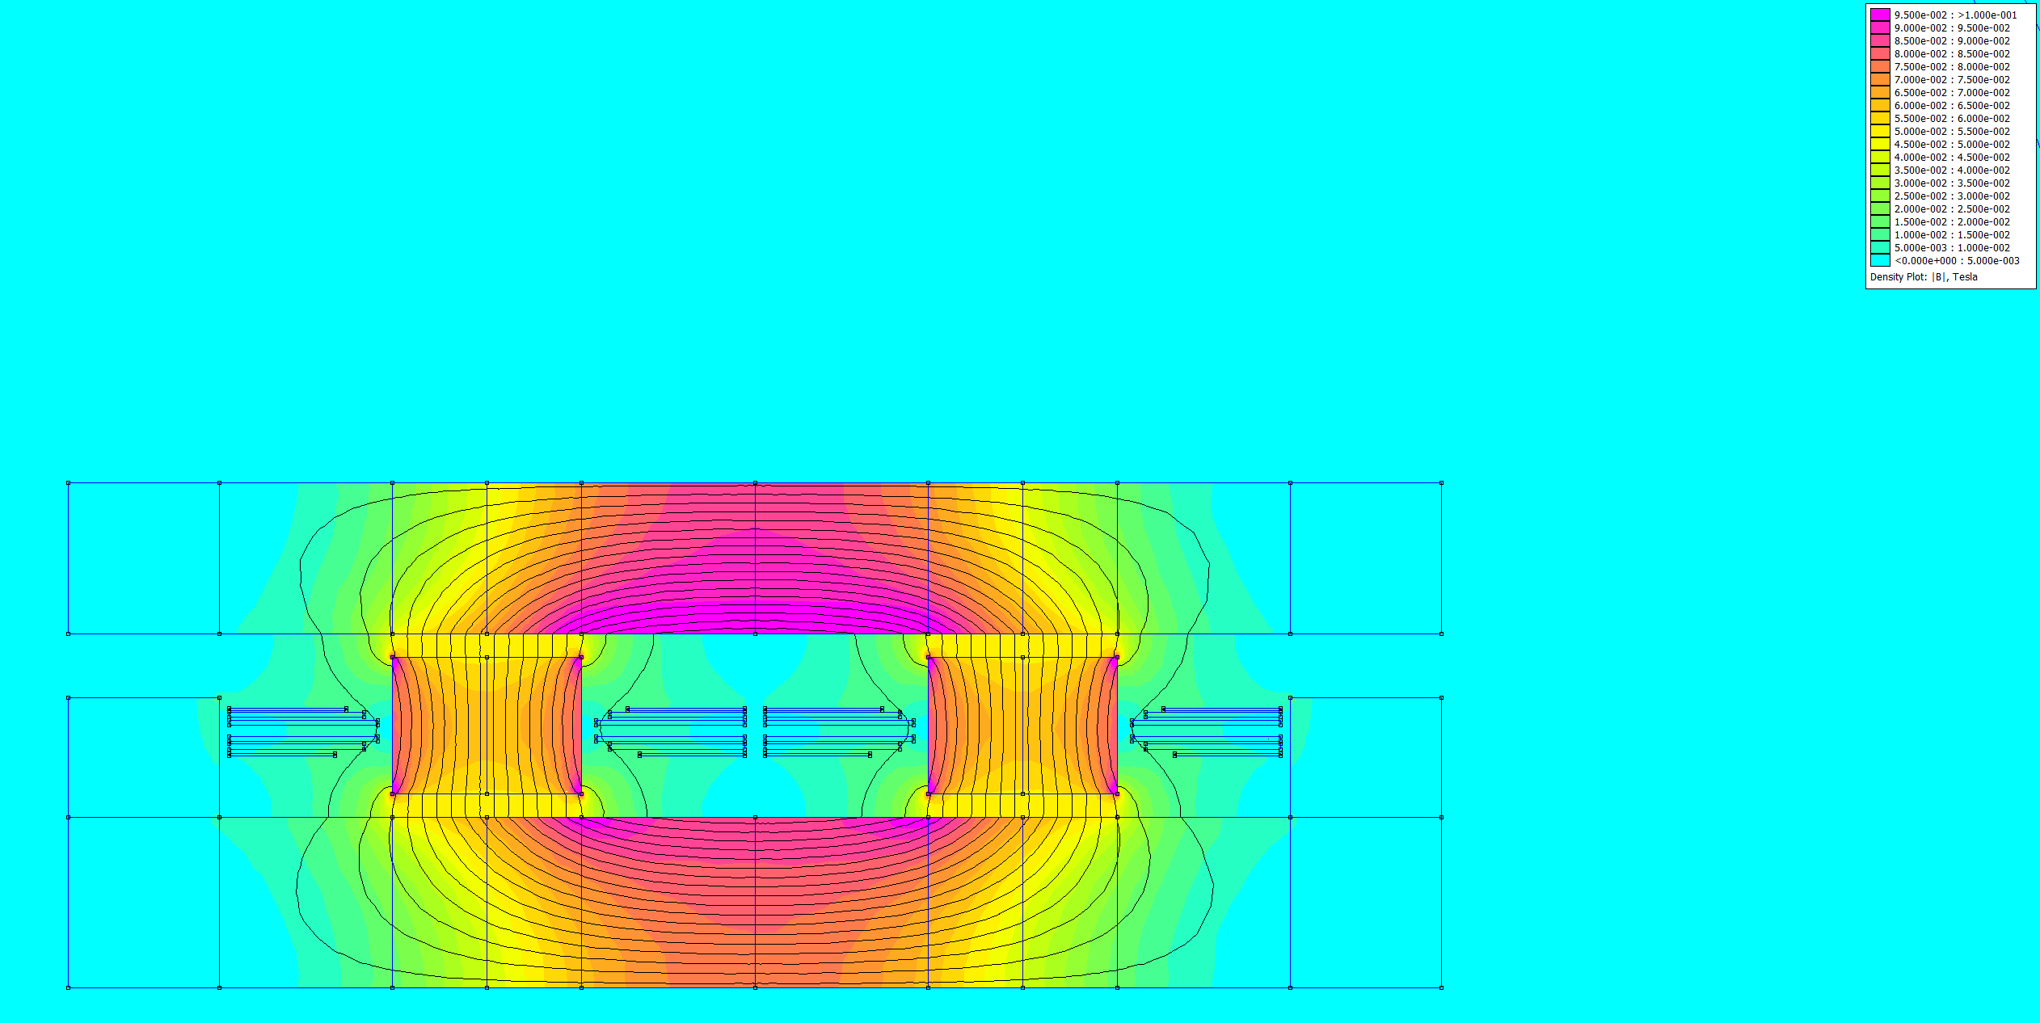
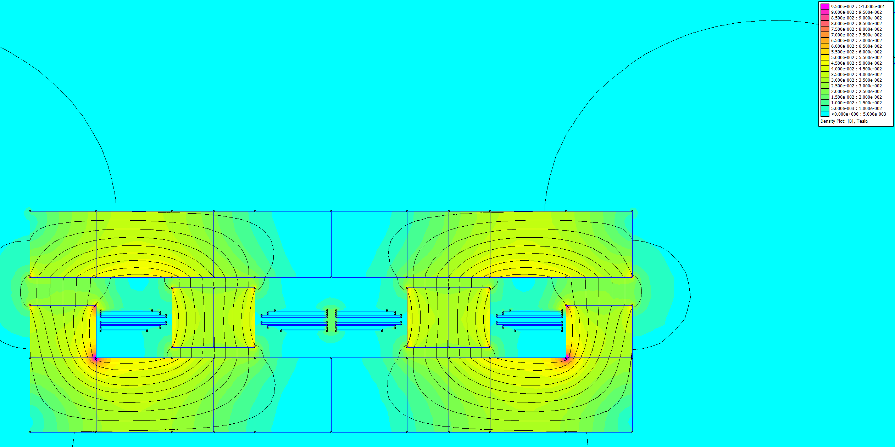
(a) Neg. Coupling DC
(b) Neg. Coupling Fundamental
(c) Pos. Coupling DC
(d) Pos. Coupling Fundamental
0 |  | 20 |  | 40 |  | 60 |  | 80 |  | 100
B[mT]

